Slide 1
Neogene Atlas Fossils

Slide 2
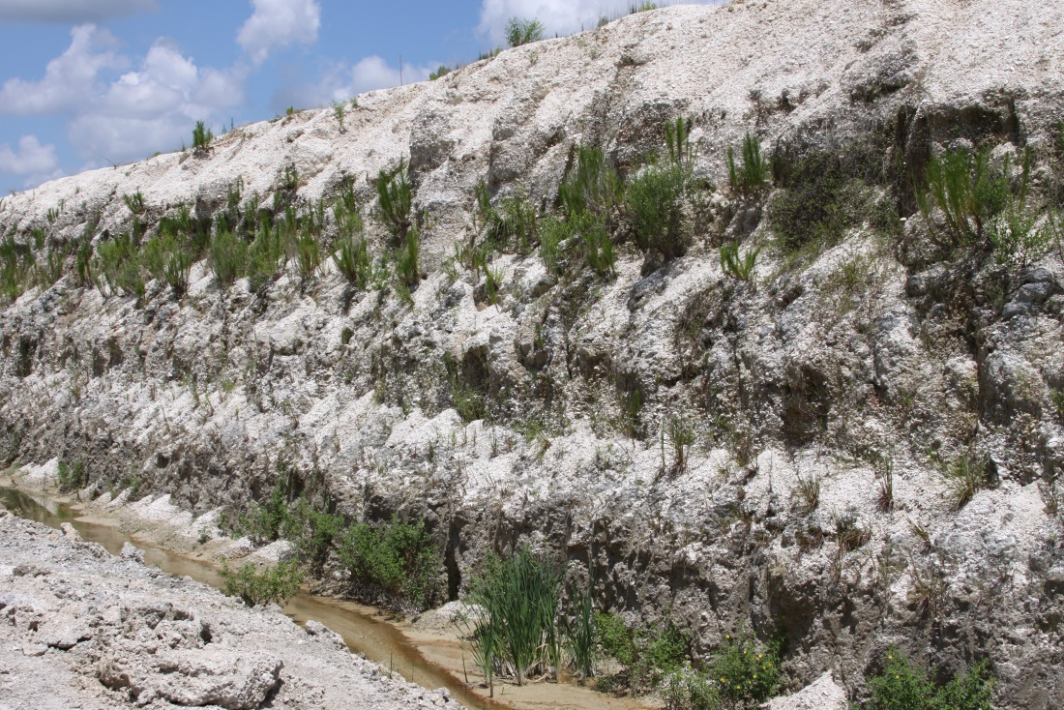
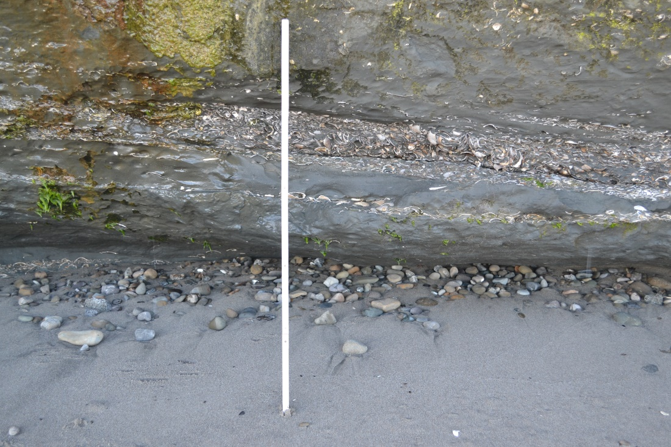
Most fossils are buried in rocks!
We find fossils when the rocks are dug up or exposed through processes like erosion.
Rocks in an area that are the same age are called formations.

Slide 3
These dots show places where fossils from the Tamiami Formation were found.

Slide 4
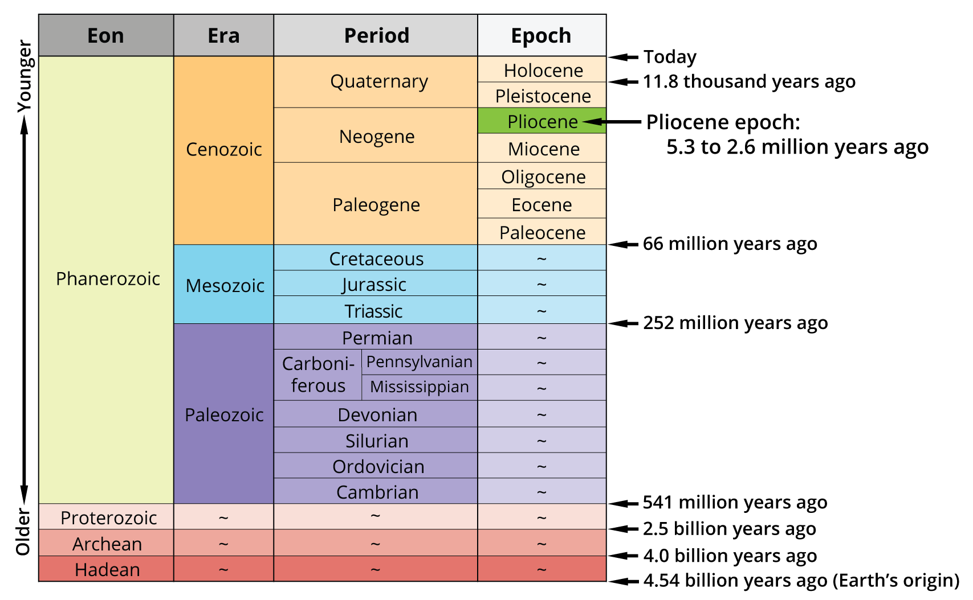
The Tamiami Formation is about 3 million years old (Pliocene Epoch).
Image is modified from Hendricks (2018), Geological Time. In: the Digital Encyclopedia of Ancient Life (http://www.digitalatlasofancientlife.org/learn/geological-time/geological-time-scale/). Creative Commons BY-SA.

