Slide 1
Neogene Atlas Fossils
Rock Layer Images

Slide 2
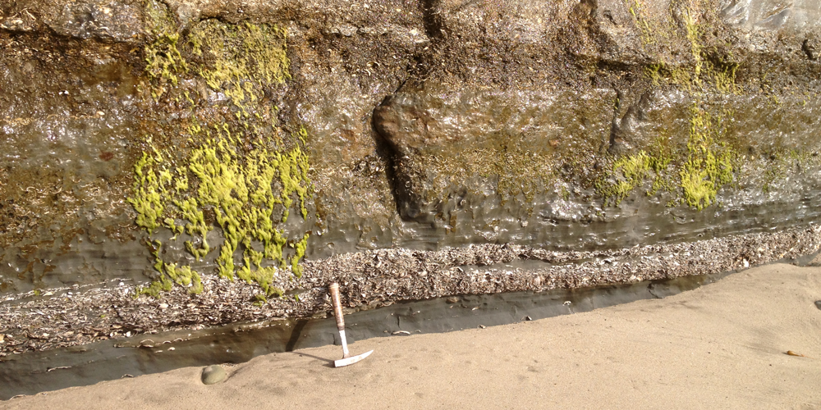
Capitola Beach, near Santa Cruz, California
Image is from Hendricks (2017), Nature of the Fossil Record. In: the Digital Encyclopedia of Ancient Life (http://www.digitalatlasofancientlife.org/learn/nature-fossil-record/the-process-of-fossilization/). Creative Commons BY-SA.

Slide 3
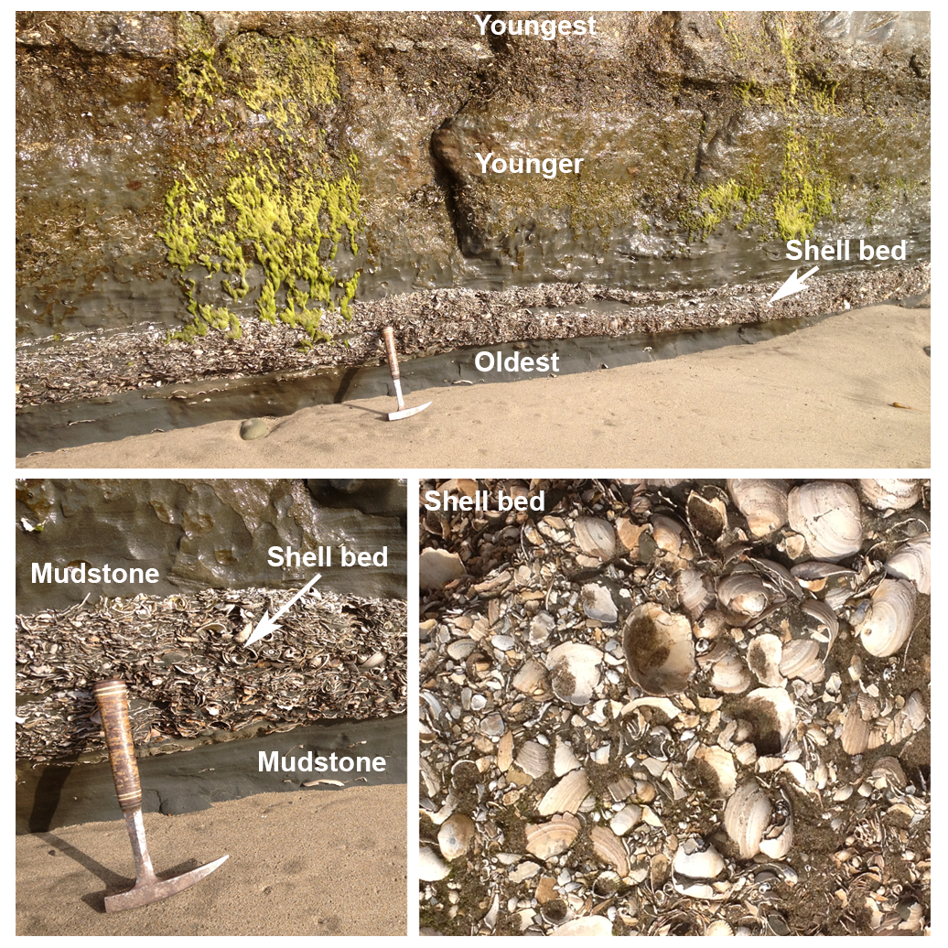
Images modified from Hendricks (2017), Nature of the Fossil Record. In: the Digital Encyclopedia of Ancient Life (http://www.digitalatlasofancientlife.org/learn/nature-fossil-record/the-process-of-fossilization/). Creative Commons BY-SA.

