Slide 1
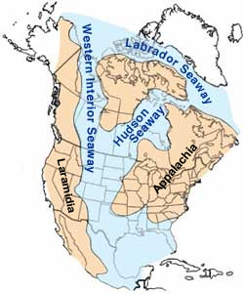
Marine Ecosystems and the Cretaceous Western Interior Seaway
By By William A. Cobban and Kevin C. McKinney, USGS. (Image has been slightly modified by uploader to remove "CO" state designation.) - https://web.archive.org/web/20050115222718/climweb.cr.usgs.gov/research/fossils/ammonites.html, Public Domain, https://commons.wikimedia.org/w/index.php?curid=69467

Slide 2
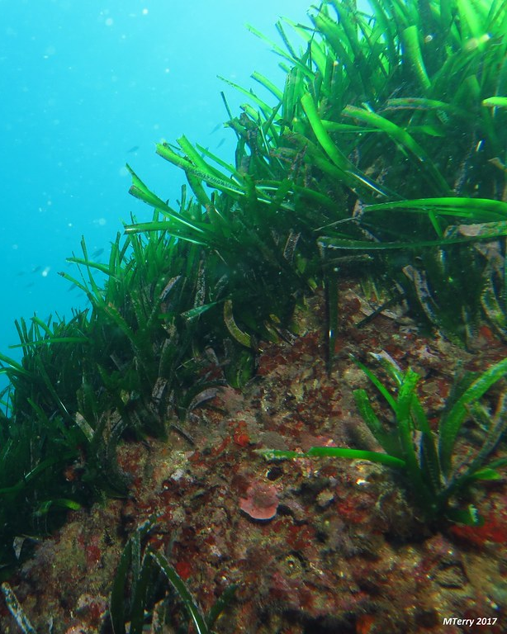
What types of things live in the ocean? What are the producers in the ocean? Turn to a partner and discuss. Be prepared to share with the class.
"Posidonia" by Marta T.L. is licensed under CC BY-NC-ND 2.0

Slide 3
"Posidonia" by Marta T.L. is licensed under CC BY-NC-ND 2.0
What are the main producers in the ocean?
If you think that the main producers are plants, move to the right side of the room. If you think that the main producers are plankton move to the left side. be prepared to justify your answer.
Notes:
Have the class split. If they think the ve them move to one side, the ones who think the water was cold to the other. Ask them to be able to justify their choice. The correct answer is warm.

Slide 4
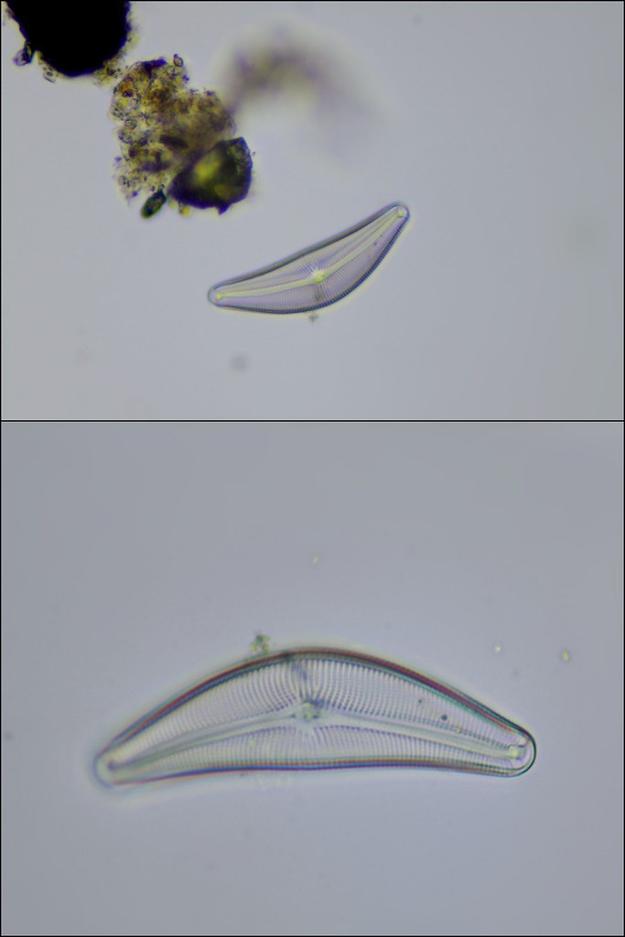
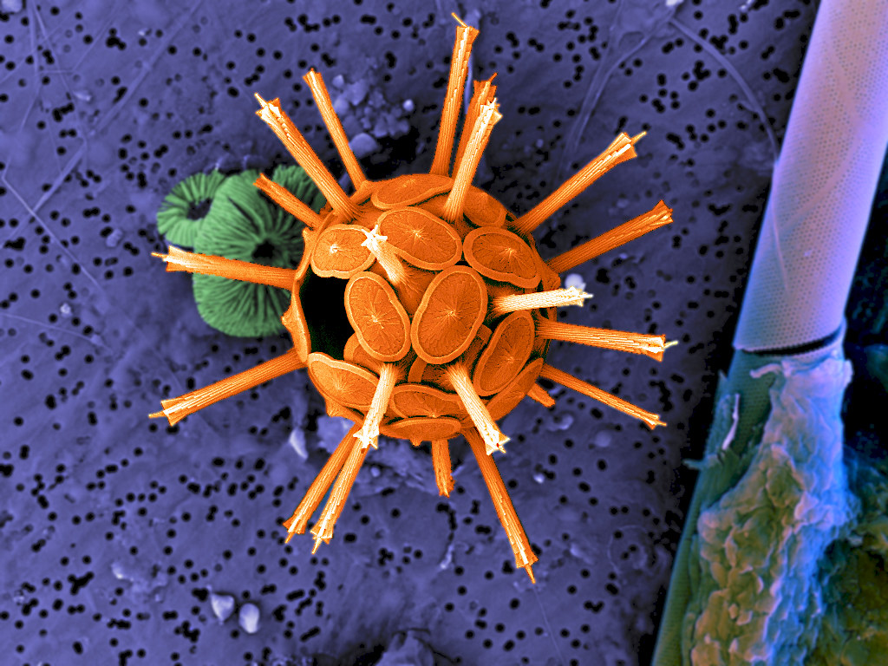
It’s not plants! These are two types of single-celled organisms that do photosynthesis!
"Lake Diatom 400x and 200x" by Specious Reasons is licensed under CC BY-NC 2.0
"Coccolith" by ZEISS Microscopy is licensed under CC BY-NC-ND 2.0

Slide 5
The Cretaceous period lasted from approximately 145 to 66 million years ago and was much warmer than it is today.
During this time from about 113-66 million years ago and covered parts of 12 states and parts of Canada.
At its greatest extent it stretched from the Gulf of Mexico to the Arctic Ocean.

Slide 6
How do we know that the Cretaceous Western Interior Seaway existed? What lines of evidence do we have?
Notes:
By By William A. Cobban and Kevin C. McKinney, USGS. (Image has been slightly modified by uploader to remove "CO" state designation.) - https://web.archive.org/web/20050115222718/climweb.cr.usgs.gov/research/fossils/ammonites.html, Public Domain, https://commons.wikimedia.org/w/index.php?curid=69467
"Lake Diatom 400x and 200x" by Specious Reasons is licensed under CC BY-NC 2.0
"Coccolith" by ZEISS Microscopy is licensed under CC BY-NC-ND 2.0

Slide 7
Different types of rocks form on land than the ones that form under water. We know where the seaway was based on these rocks. We also find fossils (like the single-celled organisms) that we know only live in water.
Notes:
By William A. Cobban and Kevin C. McKinney, USGS. (Image has been slightly modified by uploader to remove "CO" state designation.) - https://web.archive.org/web/20050115222718/climweb.cr.usgs.gov/research/fossils/ammonites.html, Public Domain, https://commons.wikimedia.org/w/index.php?curid=69467
"Lake Diatom 400x and 200x" by Specious Reasons is licensed under CC BY-NC 2.0
"Coccolith" by ZEISS Microscopy is licensed under CC BY-NC-ND 2.0

Slide 8
So if these single-celled organisms are the producers, what eats them? Turn to a partner and discuss again.
"Coccolith" by ZEISS Microscopy is licensed under CC BY-NC-ND 2.0

Slide 9
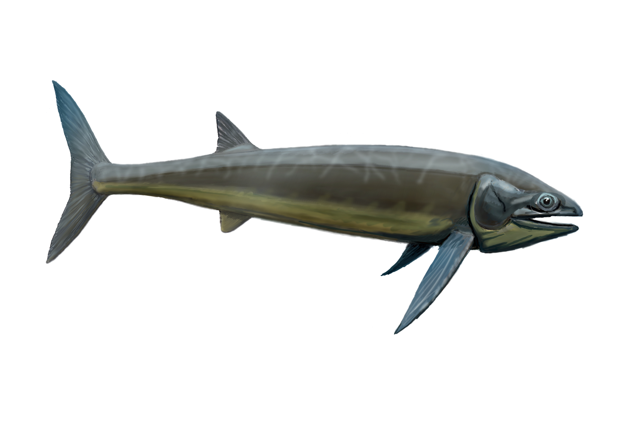
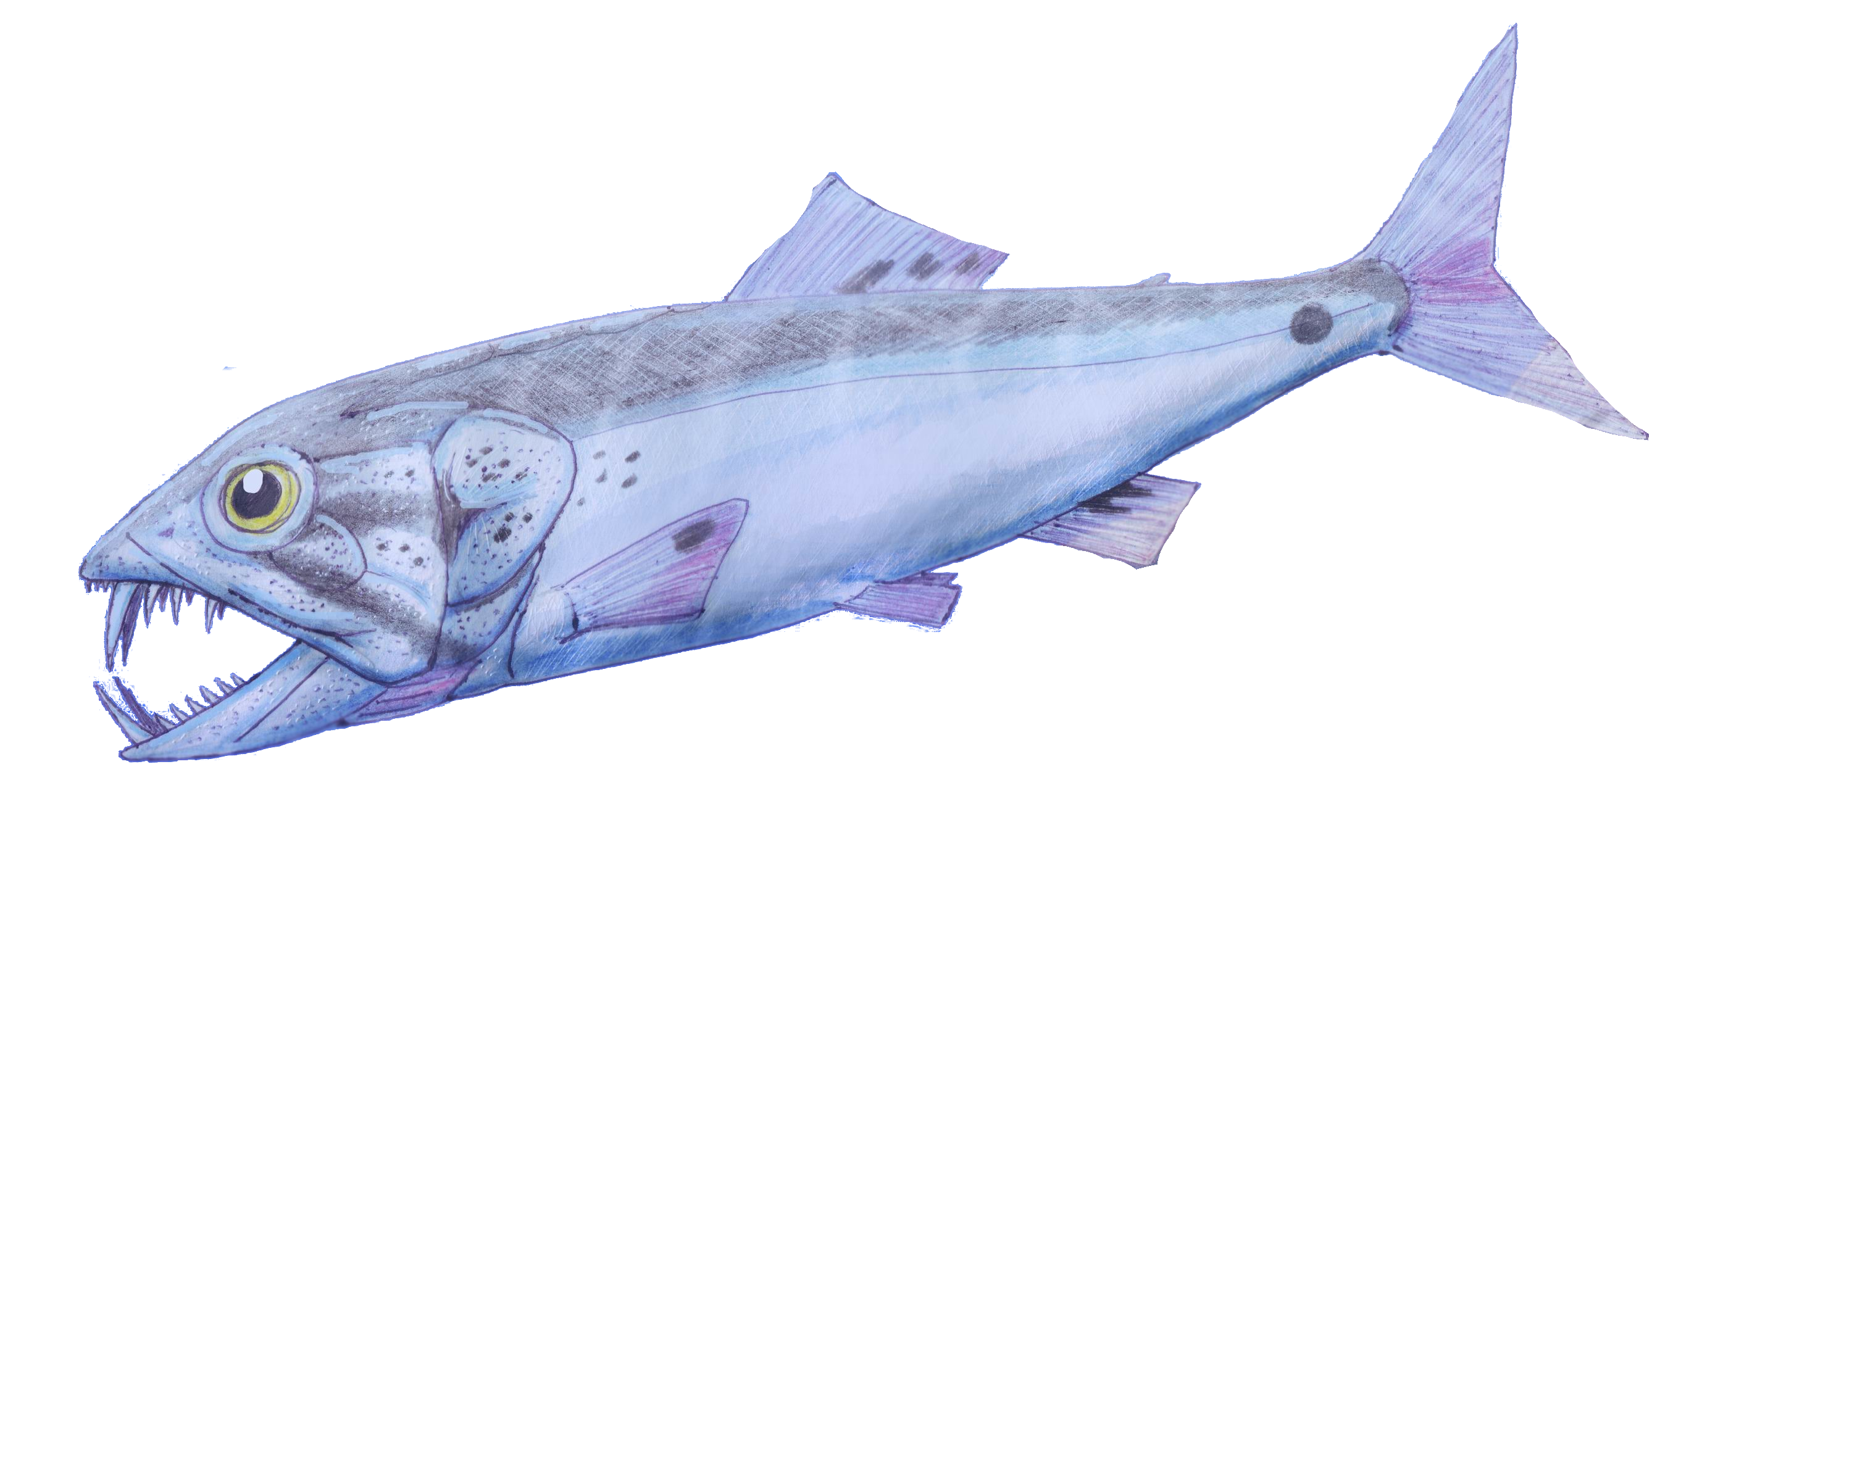
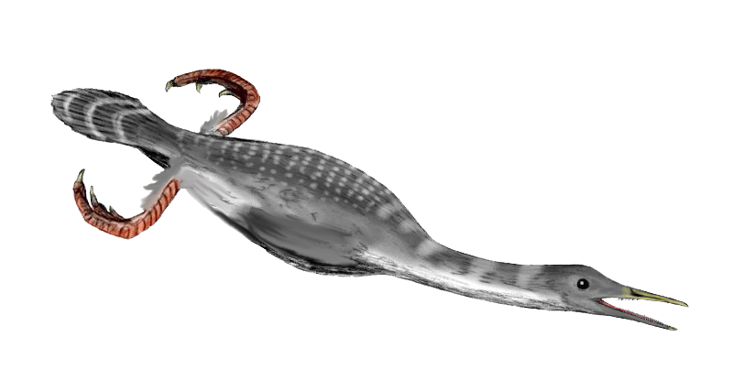
Animals of the Western Interior Seaway
Small/Medium Bony Fish
Eat plankton when very young
Eat bigger things as they get older
>1 foot-5 feet long
Large Filter-feeding Fish
Eat plankton their entire lives
>20 feet long when fully grown
Hesperornis
Aquatic flightless birds similar to penguins
Ate small/medium fish
Ranged from 3-6 feet long when fully grown
Notes:
Enchodus: By Creator: Dmitry Bogdanov - dmitrchel@mail.ru, CC BY 3.0, https://commons.wikimedia.org/w/index.php?curid=4871770
Bonnerichthys: By DiBgd - Own work, CC BY-SA 4.0, https://commons.wikimedia.org/w/index.php?curid=42226537
Hesperornis: http://spinops.blogspot.com Nobu Tamura CC BY 3.0

Slide 10
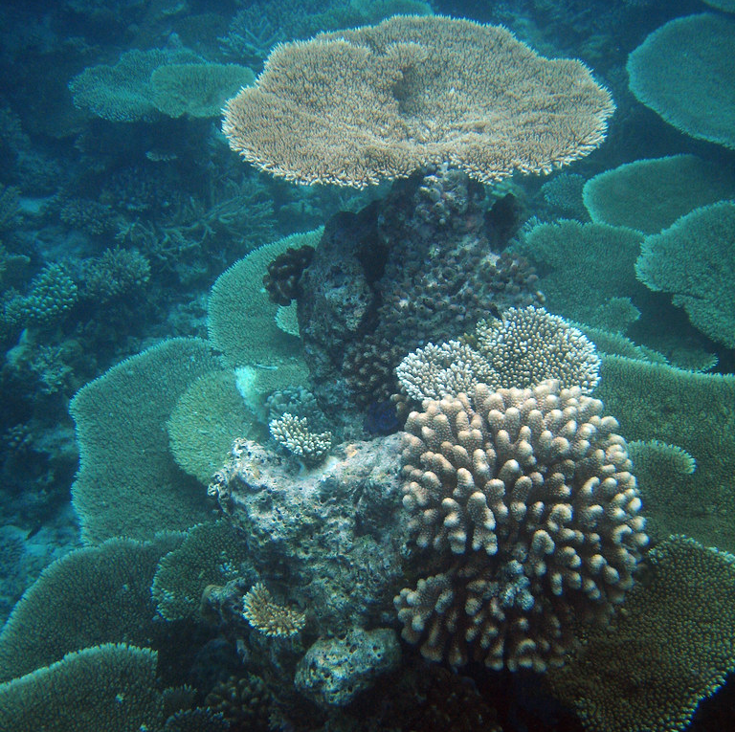
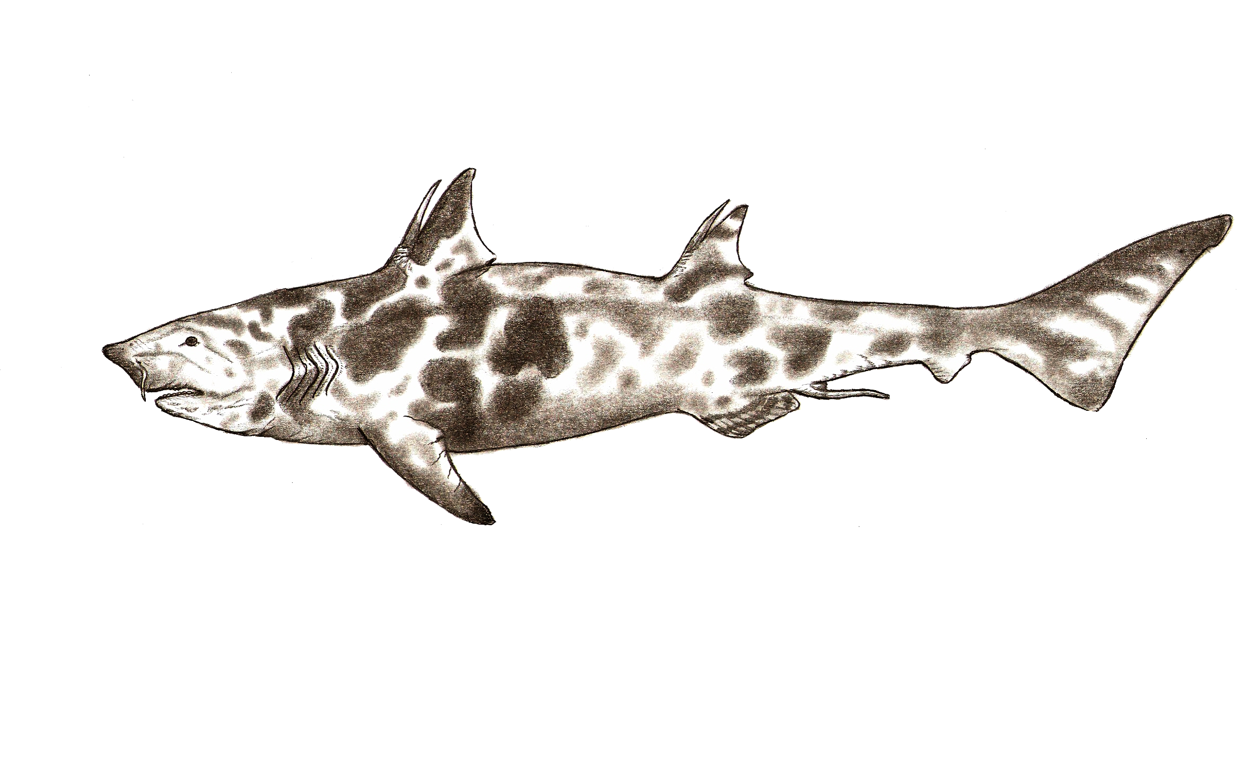
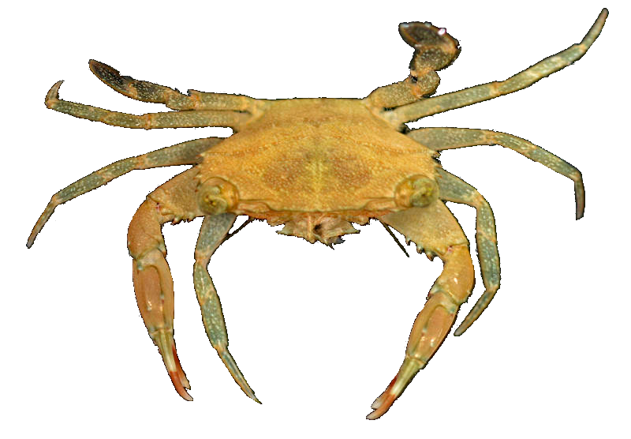
Animals of the Western Interior Seaway
Corals
Live on the shallow ocean floor
Do photosynthesis and catch plankton
Crustaceans
Live as plankton when young
Settle to seafloor as they get older
Eat a variety of things from fish to dead plankton on the seafloor
Crushing Sharks
Eat hard-shelled animals that live on the ocean floor like clams and crabs
Up to 33 feet long when fully grown
Notes:
"Diving Maldives, 2009" by Christian Steen is licensed under CC BY 2.0
Ptychodus: By Teratophoneus - http://www.deviantart.com/art/Ptychodus-mortoni-533593712, CC BY-SA 4.0, https://commons.wikimedia.org/w/index.php?curid=56836236

Slide 11
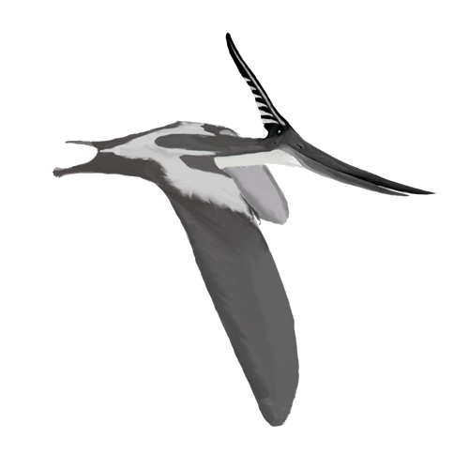
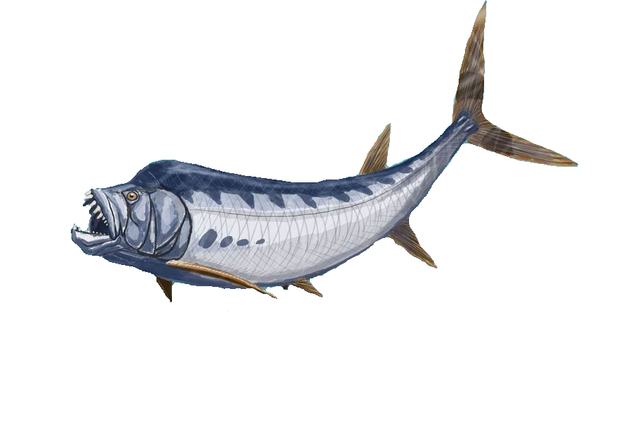
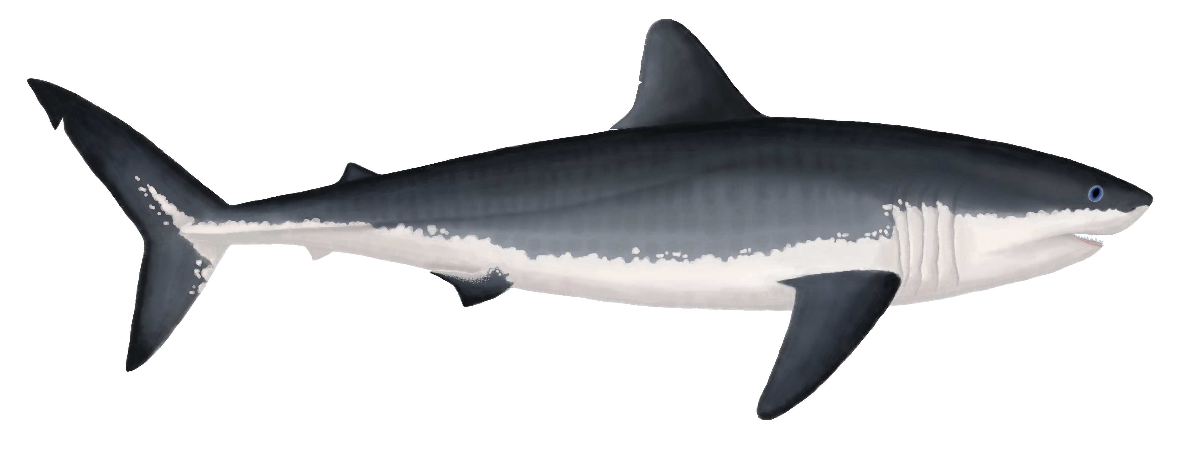
Animals of the Western Interior Seaway
Pterosaurs
Flying reptiles that flew out to the ocean to eat
Ate small/medium sized fish
Xiphactinus
Large carnivorous fish
Ate anything that fit in its mouth
Up to 20 feet long when fully grown
Carnivorous Sharks
Functioned mostly like modern-day sharks
Ate medium/large fish and smaller marine reptiles
Up to 26 feet long in larger species
Notes:
Pteranodon: By Matt Martyniuk - Own work, CC BY 3.0, https://commons.wikimedia.org/w/index.php?curid=12531610
Xiphactinus: By ДиБгд at Russian Wikipedia - Transferred from ru.wikipedia to Commons., Public Domain, https://commons.wikimedia.org/w/index.php?curid=2460152
Cretoxyrhina: By Damouraptor - Own work, CC BY-SA 4.0, https://commons.wikimedia.org/w/index.php?curid=75421994

Slide 12
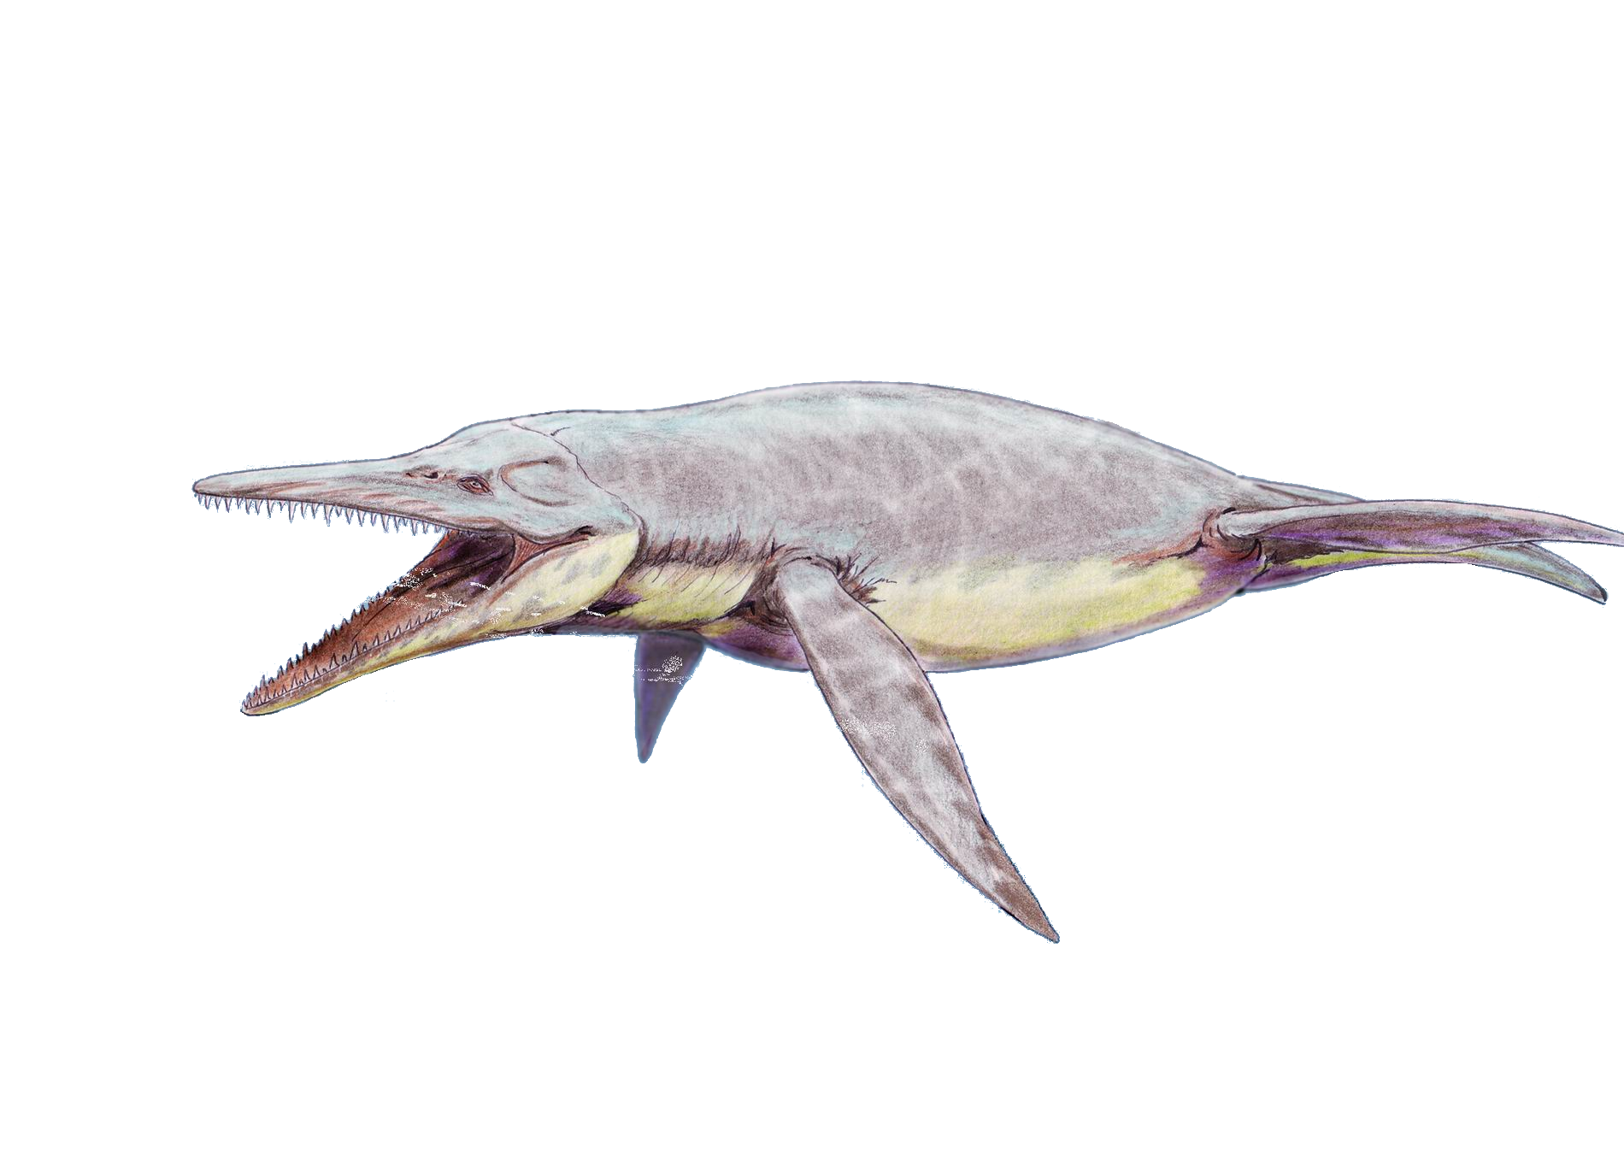
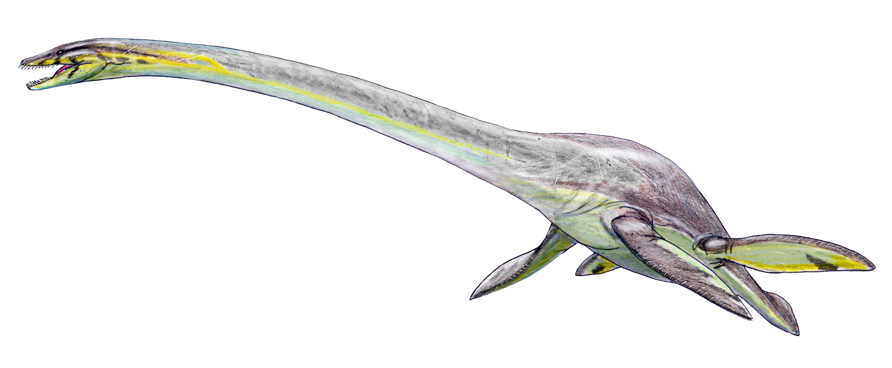
Animals of the Western Interior Seaway
Mosasaurs
Predators
Fast-swimming
Ate almost anything they could catch
Anywhere from 3-45 feet long
Short-necked Plesiosaurs
Predators
Ate almost anything they could catch
Anywhere from 10-25 feet long
Long-necked Plesiosaurs
Predators
Ate only smaller fish
Anywhere from 9-45 feet long
Notes:
Tylosaurus: By DiBgd - Own work, CC BY-SA 4.0, https://commons.wikimedia.org/w/index.php?curid=42206310
Elasmosaurus: By DiBgd - Own work, CC BY-SA 4.0, https://commons.wikimedia.org/w/index.php?curid=42521876
Brachauchenius: By Dmitry Bogdanov - dmitrchel@mail.ru, CC BY 3.0, https://commons.wikimedia.org/w/index.php?curid=3486385

Slide 13
How Do We Know What They Ate?
Rarely we find fossils of animals that died just after they ate something, and this food was also fossilized. Here we can see a Xiphactinus fossil after it has eaten another large fish.

Slide 14
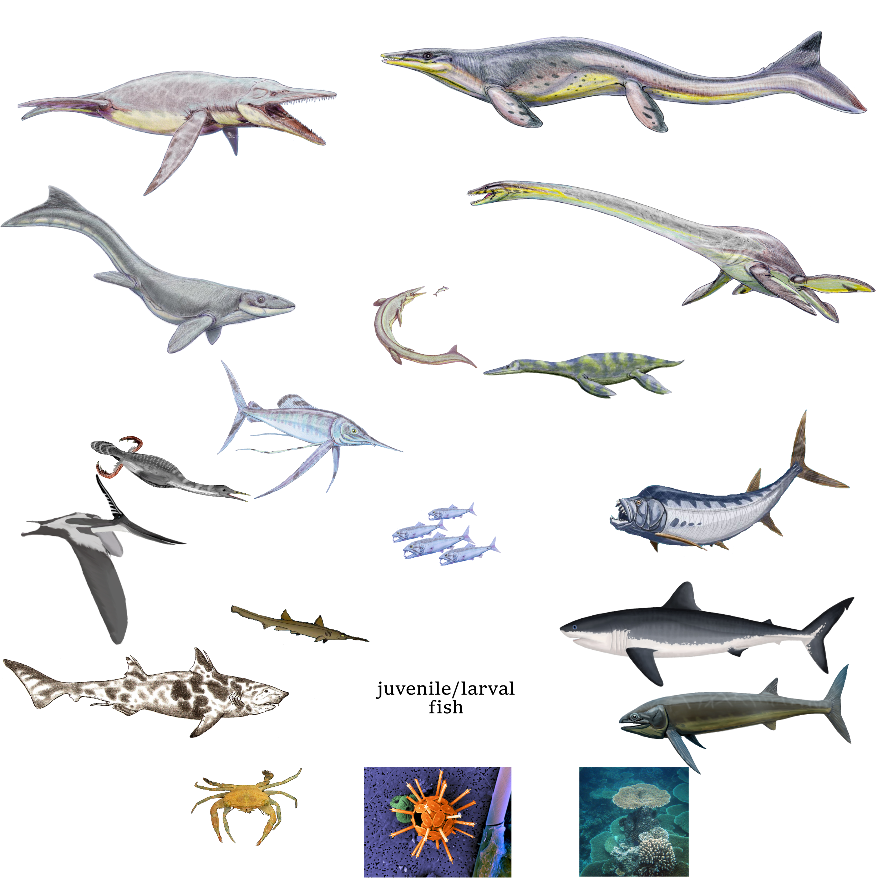
Western Interior Seaway Food Web
Notes:
Have students use the information from previous slides to fill in the wood web in their work sheet while teacher does the same by drawing on the slide. No food web will be completely perfect because we’re using extinct organisms so make that’s explained. Also explain that larger on the food web = large in life (except the single-celled organism, coral, and crab). Give 5-10 minutes depending on class. Call on a few to come up and draw a few arrow from food to consumer on the board.

Slide 15
Western Interior Seaway Food Web
Notes:
Have students use the information from previous slides to fill in the wood web in their work sheet while teacher does the same by drawing on the slide. No food web will be completely perfect because we’re using extinct organisms so make that’s explained. Also explain that larger on the food web = large in life (except the single-celled organism, coral, and crab). Give 5-10 minutes depending on class. Call on a few to come up and draw a few arrow from food to consumer on the board.

